Slide 1
Sequential Circuits : Definitions and Classification
M. Balakrishnan
Dept. of Comp. Sci. & Engg.
I.I.T. Delhi

Slide 2
Definitions
Output is a function of not only the present input but also past inputs
In synchronous sequential circuits (one under discussion right now) the time is discretised using clock input
State captures the “relevant” history of inputs in a compact form

Slide 3
Classification
Finite memory : Only a finite number of past inputs are required to generate the present output
e.g. pattern recognition
Infinite memory : All the past inputs are required to generate the present output
e.g. parity generator

Slide 4
Representation
Machine M is a five tuple
M = < I, O, S, f, g >
I : Input set
O : Output set
S : State space
f is a function mapping I Χ S ⇒ O
g is a function mapping I Χ S ⇒ S

Slide 5
Parity Generator Example
Define two states
S0: Number of 1’s received
till now is even
S1: Number of 1’s received
till now is odd
S0
S1

Slide 6
Pattern Recognition Example
P = ‘1101’
S0: No match till time t
S1: 1-bit match till time t
S2: 2-bit match till time t
S3: 3-bit match till time t
S0
S1
S2
S3

Slide 7
Temporal Iteration vs Spatial Iteration
Iterative Circuits: Spatial iteration
State machines: Temporal iteration

Slide 8
Mealy Machine
f: I Χ S ⇒ O
o(t) = f(i(t), s(t))
g: I Χ S ⇒ S
s(t+1) = g(i(t), s(t))

Slide 9
Moore Machine
f: S ⇒ O
o(t) = f(s(t))
g: I Χ S ⇒ S
s(t+1) = g(i(t), s(t))

Slide 10
State Encoding
Consider a machine with n states and say k bits are required to encode it
1-hot encoding: k=n
2-hot encoding: ^{k}C₂ ≥ n
Minimal encoding: k = ⎡log₂n⎤
Any other encoding: n ≥ k ≥ ⎡log₂n⎤

Slide 11
Sequential Circuits : State Equivalence & Minimization
M. Balakrishnan
Dept. of Comp. Sci. & Engg.
I.I.T. Delhi

Slide 12
Terminology
Equivalent states
Distinguishable states
k-equivalent states
k-distinguishable states

Slide 13
Parity Generator Example
0/0
States S0 and S1
are 1-distinguishable
S0
1/0
1/1
S1
0/1

Slide 14
Pattern Recognition Example
0/0
Pattern = ‘1101’
S0, S1 and S2 are 1-equiv.
S2 and S3 are1-disting.
S0 and S1 are 2-equiv.
S0
1/0
1/0
S1
0/0
0/0
S2
1/0
0/0
1/1
S3

Slide 15
State Machine Minimization
Identify equivalent states
Replace equivalent states by one state

Slide 16
Theorem for State Equivalence
Two states S_{i} and S_{j} are k+1 equivalent if and only if
they are k-equivalent
and their next states for all inputs are k-equivalent

Slide 17
Proof: State Equivalence Theorem
α ⁄ β
S_{i}^{k+1}
S_{i}
S_{i}¹
α ⁄ β
S_{j}
S_{j}¹
S_{j}^{k+1}

Slide 18
Minimization Steps
Consider all states to be 0-equivalent
Identify 1-equivalent partition P₁ based on outputs
repeat
  identify i+1 equivalent partition P_{i+1} based on P_{i}
  until (P_{i+1} = P_{i})
Replace each set of states in a P_{i} class by a state and define state transitions accordingly

Slide 19
State Minimization: Example
P₀ = {Si,S0,S1,S00,S01,S10,S11}
P1 = {(Si,S0,S1,S00,S10,S11)(S01)}
P2 = {(Si,S0,S00)(S1,S10,S11)
(S01)}
P2 = {(Si,S0,S00)(S1,S10,S11)
(S01)}
Si
0/0
1/0
S0
S1
0/0
1/0
0/0
1/0
S00
S10
S01
S11

Slide 20
State Minimization: Example (contd.)
0/0
a
Si
0/0
1/0
1/0
S0
S1
1/0
b
0/0
0/0
1/0
0/0
1/0
0/0
1/1
S00
S10
S01
S11
c

Slide 21
Equivalent Mealy & Moore Machines
Mealy → Moore
  For every state with distinct outputs on incident edges, split it into as many states as number of distinct outputs
  Associate the edge output with the state
  Redirect the edges appropriately
  Define the new edges from the split states as per the original Mealy machine

Slide 22
State Machine Synthesis
M. Balakrishnan
Dept. of Comp. Sci. & Engg.
I.I.T. Delhi

Slide 23
Equivalent Mealy & Moore Machines
Mealy → Moore
  For every state with distinct outputs on incident edges, split it into as many states as number of distinct outputs
  Associate the edge output with the state
  Redirect the edges appropriately
  Define the new edges from the split states as per the original Mealy machine

Slide 24
Transforming Mealy to Moore: Example
0/0
0
S0
S00/0
1/0
1
1/1
1
S1
S11/1
0/1
0

Slide 25
Equivalent Machines: Waveforms
Clk
x
S0
S1
S1
S1
S0
Mealy
S00
S11
S11
S11
S00
Moore

Slide 26
Transforming Moore to Mealy: Example
0/1
A/0
0/1
AD
0
1
1/0
X
X/0
1
1/1
B/1
C/0
C
B
0
0
D/1
1

Slide 27
State Register Realization
A set of Flip-flops
SR flip-flop Q(t+1) = R’(t)Q(t) + S(t)
S(t)R(t) = 0
JK flip-flop Q(t+1) = K’(t)Q(t) + J(t)Q’(t)
D flip-flop Q(t+1) = D(t)
T flip-flop Q(t+1) = T’(t)Q(t) +T(t)Q’(t)

Slide 28
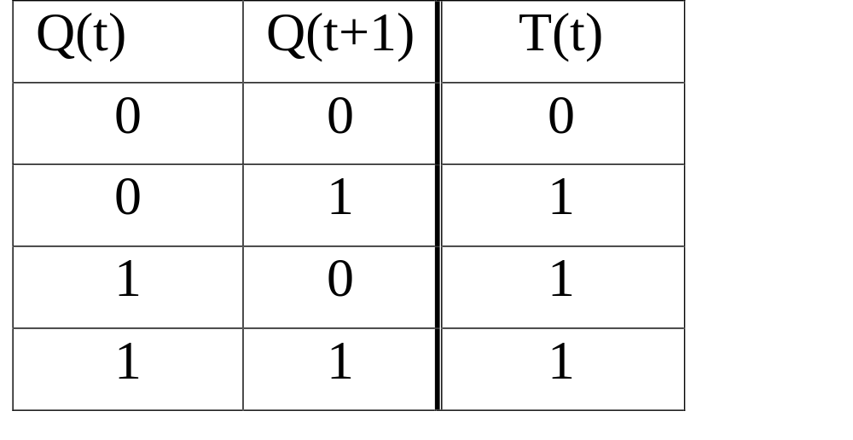
Excitation Table: T Flip-flop

Slide 29
State Machine Realization
State Encoding
AD 00
B 01
C 10
0/1
0/1
AD
1/0
X/0
1/1
B
C

Slide 30
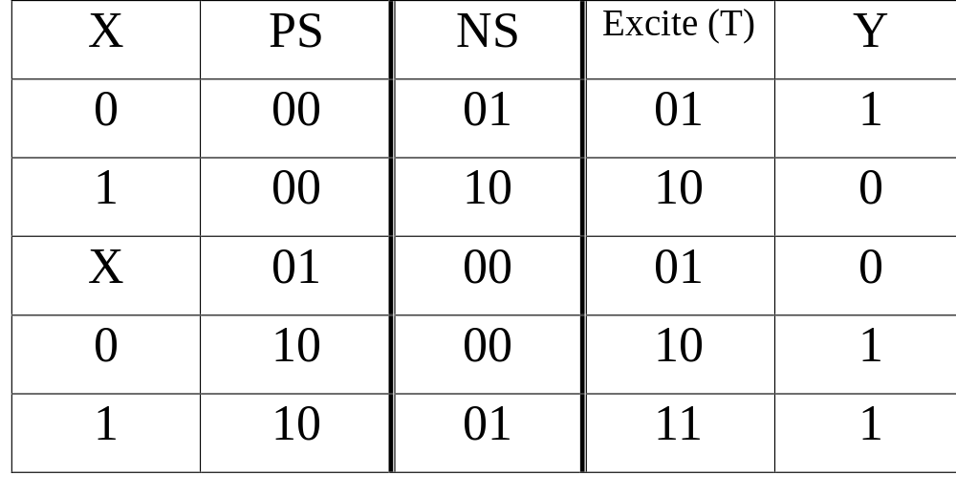
State Machine Realization (contd.)

Slide 31
Circuit Realization
x
y
Comb
Logic
T1
T2

Slide 32
Steps in State Machine Synthesis
Convert the description into state machine
Minimize the state machine
Encode the states
Choose a set of flip-flops for state register
Use the excitation table to arrive the specification of the combinational logic
Synthesize the combinational logic

Slide 33
State Machine Implementation Using Registers & Counters
M. Balakrishnan
Dept. of Comp. Sci. & Engg.
I.I.T. Delhi

Slide 34
Registers & Latches
An array of flip-flops
Edge triggered are generally referred to as registers while latches are level triggered (transparent latches)
D
Q
Clk

Slide 35
Register & Latch Waveforms
Clk
D
Level
Edge

Slide 36
Register Control Variations
LD
OE
LD/EN

Slide 37
Counters
Ripple counter
Synchronous counters
  Synchronous controls
  Asynchronous controls
  Mixed controls

Slide 38
Ripple Counter
T
Q
T
Q
T
Q
T
Q
Clk
Q0
Q1

Slide 39
Ripple Counter
Advantages
  Simple low cost design
  High speed operation possible if outputs are not required to be synchronous
Disadvantages
  Delay = no. of bits × flip-flop delay
  Illegal transient states

Slide 40
Synchronous Counter
T
Q
T
Q
T
Q
T
Q
Clk
Q0
Q1

Slide 41
Faster Synchronous Counter
T
Q
T
Q
T
Q
T
Q

Slide 42
Cascadable Synchronous Counters
ENT
C
ENT
ENT
ENT
ENP
ENP
C
ENP
C
ENP
C
En
Clk
Carry delay is spread over 16 clock cycles

Slide 43
Synchronous Counter with Synchronous Controls
D
Q
Counter
Clk
Clr
En
Ld

Slide 44
Design Example: Mod 10 Counter
S(t+1) = s(t) + 1 if 0 ≤ s(t) ≤ 8
0 otherwise
Synch
Count
Async
Count
Dec 9
Dec 10
Clr
Clr

Slide 45
State Machine Realization
State Encoding
A 00
B 01
C 10
0/1
0/1
A
1/0
X/0
1/1
B
C

Slide 46
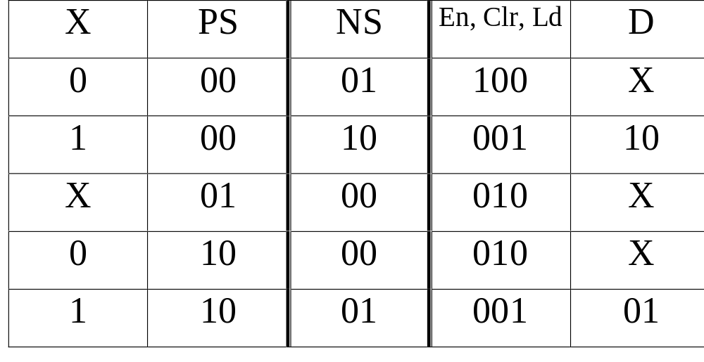
State Machine Realization (contd.)

Slide 47
Circuit Realization
x
y
Comb
Logic
D
En, Clr, Ld
C
N
T
Q
(PS)

Slide 48
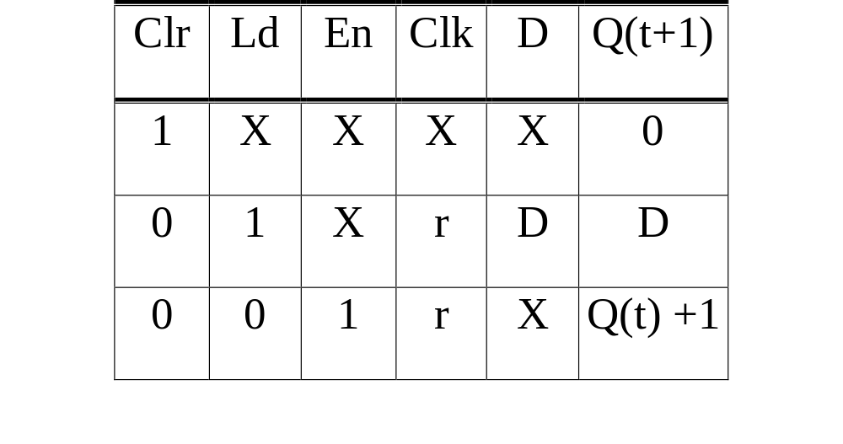
Sample Counter Specification

Slide 49
Steps in State Machine Synthesis using Counters
Encode the states
Choose a counter with appropriate control inputs to implement the state register
Use the counter functionality table to arrive at the spec. of the combinational logic
Synthesize the combinational logic

Slide 50
Multiple State Machine Implementation & Clock Period
M. Balakrishnan
Dept. of Comp. Sci. & Engg.
I.I.T. Delhi

Slide 51
Steps in State Machine Synthesis using Counters
Encode the states
Choose a counter with appropriate control inputs to implement the state register
Use the counter functionality table to arrive at the spec. of the combinational logic
Synthesize the combinational logic

Slide 52
Applications of Sequential Machines
Pattern matching
  Overlapped or non-overlapped
  Blocked or non-blocked
Sequential decoding
Controllers
Memory based circuits

Slide 53
Interacting State Machines : Example
Search for a pattern P = ‘1101’ within blocks of 256 bits. The pattern should not cross block boundaries.
Design two state machines M1 and M2
  M1 is a modulo 256 counter
  M2 is the pattern recognizer
The 256th transition of M1 should initialize M2

Slide 54
Example (Contd.)
0/0
A
S0
0/0
1/0
S255
S1
B
1/0
1/0
S2
C
1/1
0/0
0/0
D

Slide 55
Example (Contd.)
x
y
M1
M2
Clk

Slide 56
Example (Contd.)
00,1x/0
00,1x/0
A
S0
-/0
01/0
-/1
1x/0
B
S255
S1
01/0
-/0
-/0
01/0
S2
C
01/1
00/0
X0/0,
11/1
-/0
D

Slide 57
Design Summary: Example
M1 : 8-bit free running counter
M2 : Counter with synchronous clear which dominates
x
M1
Clr
M2
y
Logic +
8-bit Cntr
2-bit Cntr
Clk

Slide 58
Register & Latch Waveforms
Clk
S253
S254
S255
S0
S1
Cntr
Mod256

Slide 59
Multiple State Machines: Another Example
In a bit stream, count the number of “@” (ASCII Code) characters in blocks of 256 8-bit characters
Three state machines: M1, M2 and M3
  M1: Pattern recognizer for “@” character
  M2: 8-bit counter for counting 256 characters
  M3: 8-bit Counter for counting no. of “@”

Slide 60
Second Example (Contd.)
Specification of M1
y1 = 1 if <x(t-7)..x(t)> = “@” and t mod 8 = 7
y2 = 1 if t mod 8 = 7
En
M2
y2
x
M1
Clr
y1
En
M3
y
Clk

Slide 61
Clock Period
x
Comb
Logic
y
PS
NS
SR
Clk
t_{su}
t_{h}

Slide 62
Clock Period Computation
t_{o}: Critical path delay (x,PS) to y
t_{ns}: Critical path delay (x,PS) to NS
t_{d}: SR delay
t_{su}: Setup time of the SR
t_{h}: Hold time of the SR
t_{clk} ≥ max{ t_{d} + t_{o}, t_{d} + t_{ns} + t_{su} }

Slide 63
Designing with Memories
M. Balakrishnan
Dept. of Comp. Sci. & Engg.
I.I.T. Delhi

Slide 64
Classification of Memory Devices
ROM
  ROM, PROM, EPROM, EEPROM, UVPROM
RAM
  SRAM (Static RAM)
  DRAM (Dynamic RAM)

Slide 65
SRAM Device Signals
Address
SRAM
Data
rd/wr
cs

Slide 66
SRAM Timing
Adr
Rd/wr
Data

Slide 67
Circuit Example using Memory
DBUS
ADBUS
RO
Adr
RAM
RI
Rd/Wr

Slide 68
Reading Memory in a SM
S1
Inc_Adr
En_Adr_src
S2
Ld_Dat_Reg

Slide 69
Writing Memory in a SM
S1
Adr
S2
Data
S3
Wr

Slide 70
Dynamic RAM Device Signals
Address
Data_out
ras
SRAM
cas
Data_in
rd/wr
cs

Slide 71
DRAM Timing
Adr
ras
cas

Slide 72
System Design Case Studies
M. Balakrishnan
Dept. of Comp. Sci. & Engg.
I.I.T. Delhi

Slide 73
Data-Control Partition
Status
signals
Data
Part
Control
Part
Control
signals

Slide 74
Steps in System Design
Choose an algorithm
Identify the data modules (operators & storage)
Identify the control signals
Extract the state machine for control
Implement the state machine to complete the design

Slide 75
Case Study1: GCD Computer
x
z
GCD
Computer
y

Slide 76
GCD Algorithm
Input x, y;
while ( x ≠ y ) do
  if ( x > y ) then x := x - y
  else y := y - x
  endif;
  endwhile;
  z := x;
  end.

Slide 77
GCD Computer: Data Part
R1
R2
Comp
R3
SUB

Slide 78
Modified GCD Algorithm (RTL)
R1:= x, R2:= y;
while ( R1 ≠ R2 ) do
if ( R1 > R2 )
then R1:= R1 - R2
else R2:= R2 - R1
endif;
endwhile;
R3:= R1;

Slide 79
GCD Computer: State Diagram
S1
S2
S5
S4
S3

Slide 80
GCD Computer: Interface
x
z
GCD
Computer
y
start
eoc

Slide 81
Case Study 2: FIFO
Data In
Data Out
FIFO
full
empty
add
delete

Slide 82
FIFO: Data Part
Head
Memory
Tail
f
e

Slide 83
FIFO: State Machine
S0
S3
S1
S4
S2

